Slide 1


Interactors
Chris Piech
CS106A, Stanford University

Slide 2
HashMap Recap
key
value
(String) animal
(String) name
(GRect) key
(String) animal sound
(int) phone number
(AudioClip) note

Slide 3
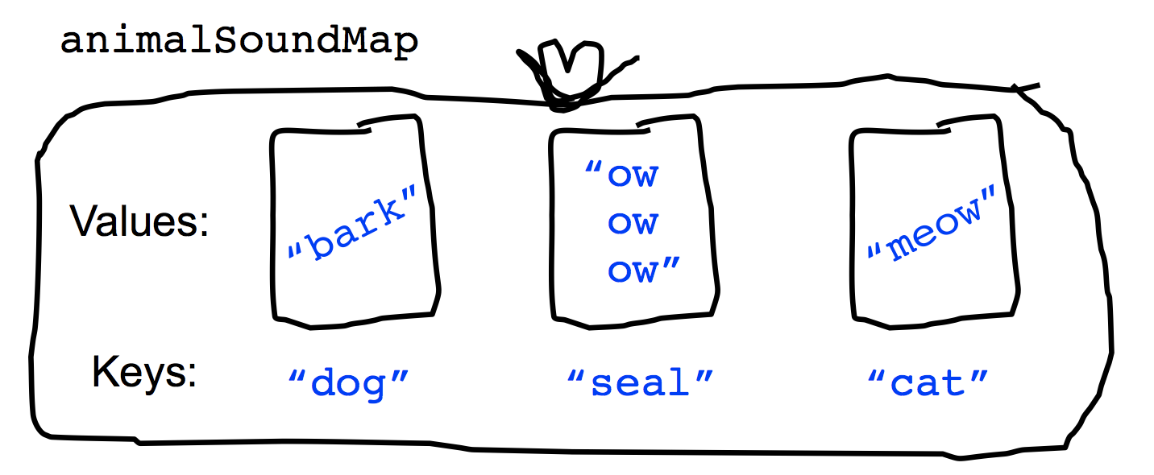
HashMap Recap
key
value
(String) animal
(String) name
(GRect) key
(String) animal sound
(int) phone number
(AudioClip) note

Slide 4
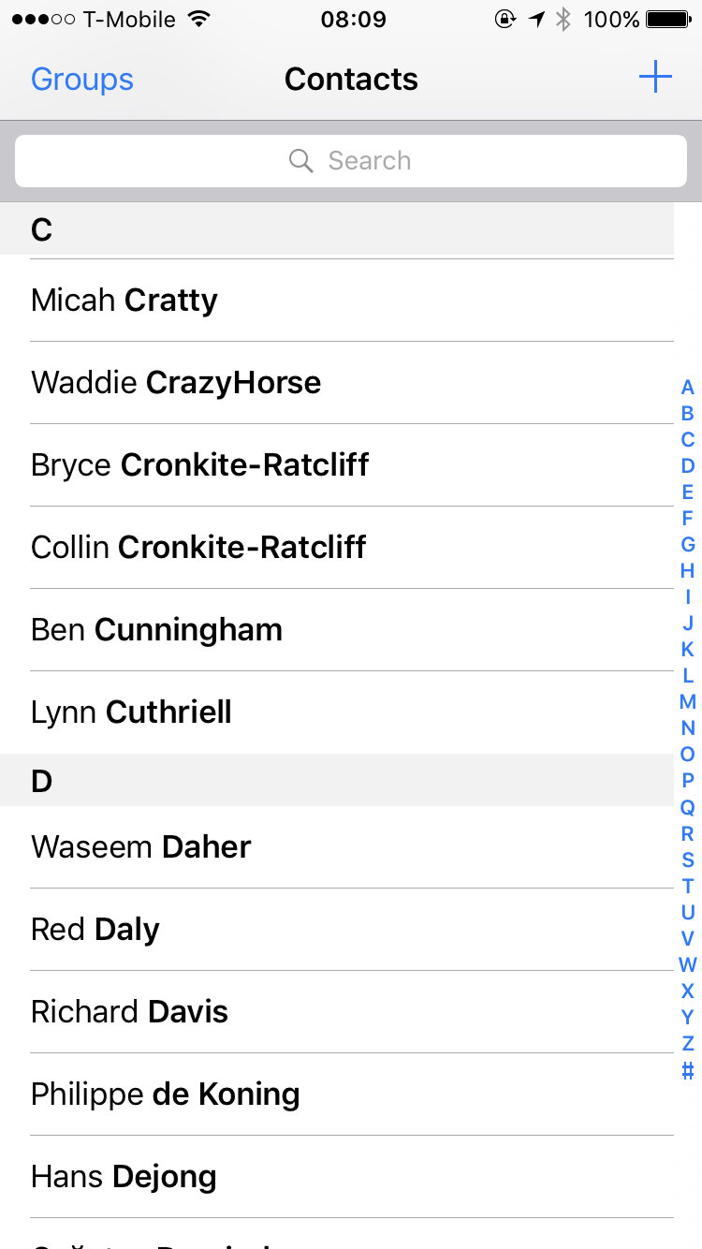
HashMap Recap
key
value
(String) animal
(String) name
(GRect) key
(String) animal sound
(int) phone number
(AudioClip) note
6701678

Slide 5
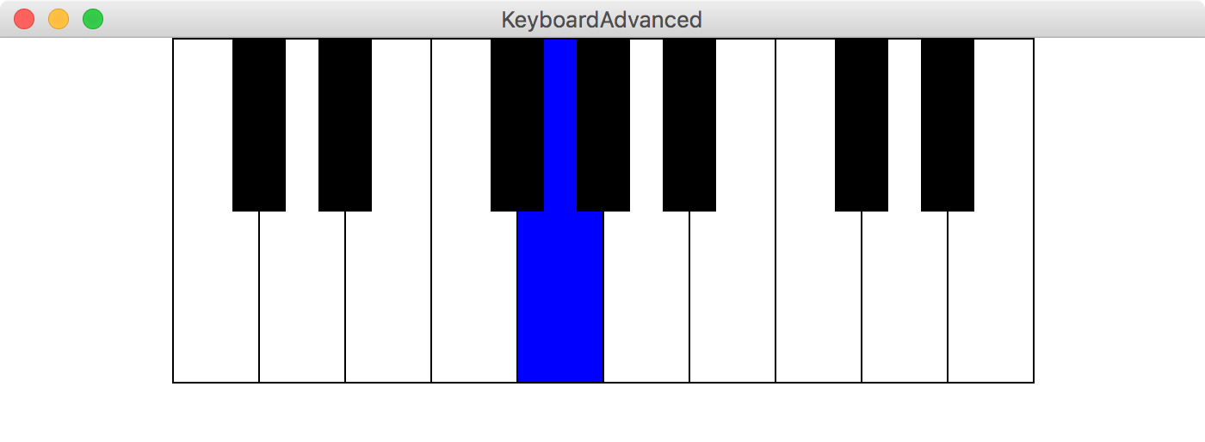
HashMap Recap
key
value
(String) animal
(String) name
(GRect) key
(String) animal sound
(int) phone number
(AudioClip) note

Slide 6
Section Leader Who
The user enters a query
You give the results

Slide 7
Section Leader Who
The user enters a query
You give the results
HashMap<String, ArrayList<String>> database;

Slide 8
Section Leader Who
The user enters a query
You give the results
HashMap<String, ArrayList<String>> database;

Slide 9
Section Leader Who
The user enters a query
You give the results
HashMap<String, ArrayList<String>> database;

Slide 10
Key
Value
piech
cpiech
chris
wang
…
["Chris Piech (cpiech)”]
["Chris Piech (cpiech)”]
[
"Chris Collins (ccollins)"
"Chris Koenig (ckoenig)"
"Chris Piech (cpiech)"
"Chris Wang (cwang)
]
Database HashMap
Approach #2: HashMap
[
"Anna Wang (awang)",
"Avery Wang (awang)",
"Chris Wang (cwang)",
"Lisa Wang (lwang)”,
…

Slide 11
HashMaps on one slide
Make a HashMap
Put and get values into a map
Some useful other methods
int size = myMap.size();
myMap.contains(key); // returns true or false if key is in map
myMap.keySet();
myMap.remove(key); // make like a tree and leave!
Iterate using a foreach loop
HashMap<KeyType, ValueType> myMap =
new HashMap<KeyType, ValueType>();
myMap.put(key, value);
myMap.get(key) // returns the corresponding value
for(keyType key : myMap.keySet()){ // not ordered
myMap.get(key); // do something with the key/value pair }

Slide 12
Interactors

Slide 13
Where are we?
Karel the Robot
Java
Console Programs
Graphics Programs
Text Processing
Data Structures
GUIs
Defining our own Variable Types

Slide 14
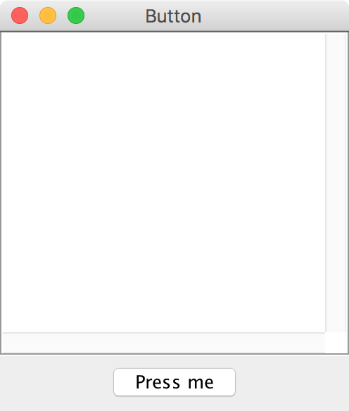
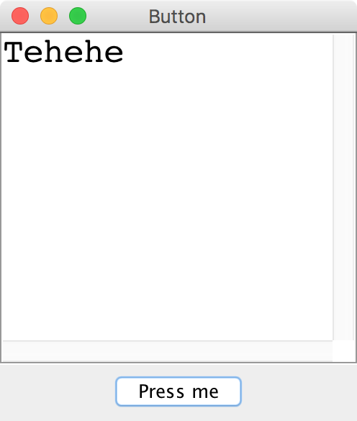
Button demo
Notes:
show Button example

Slide 15
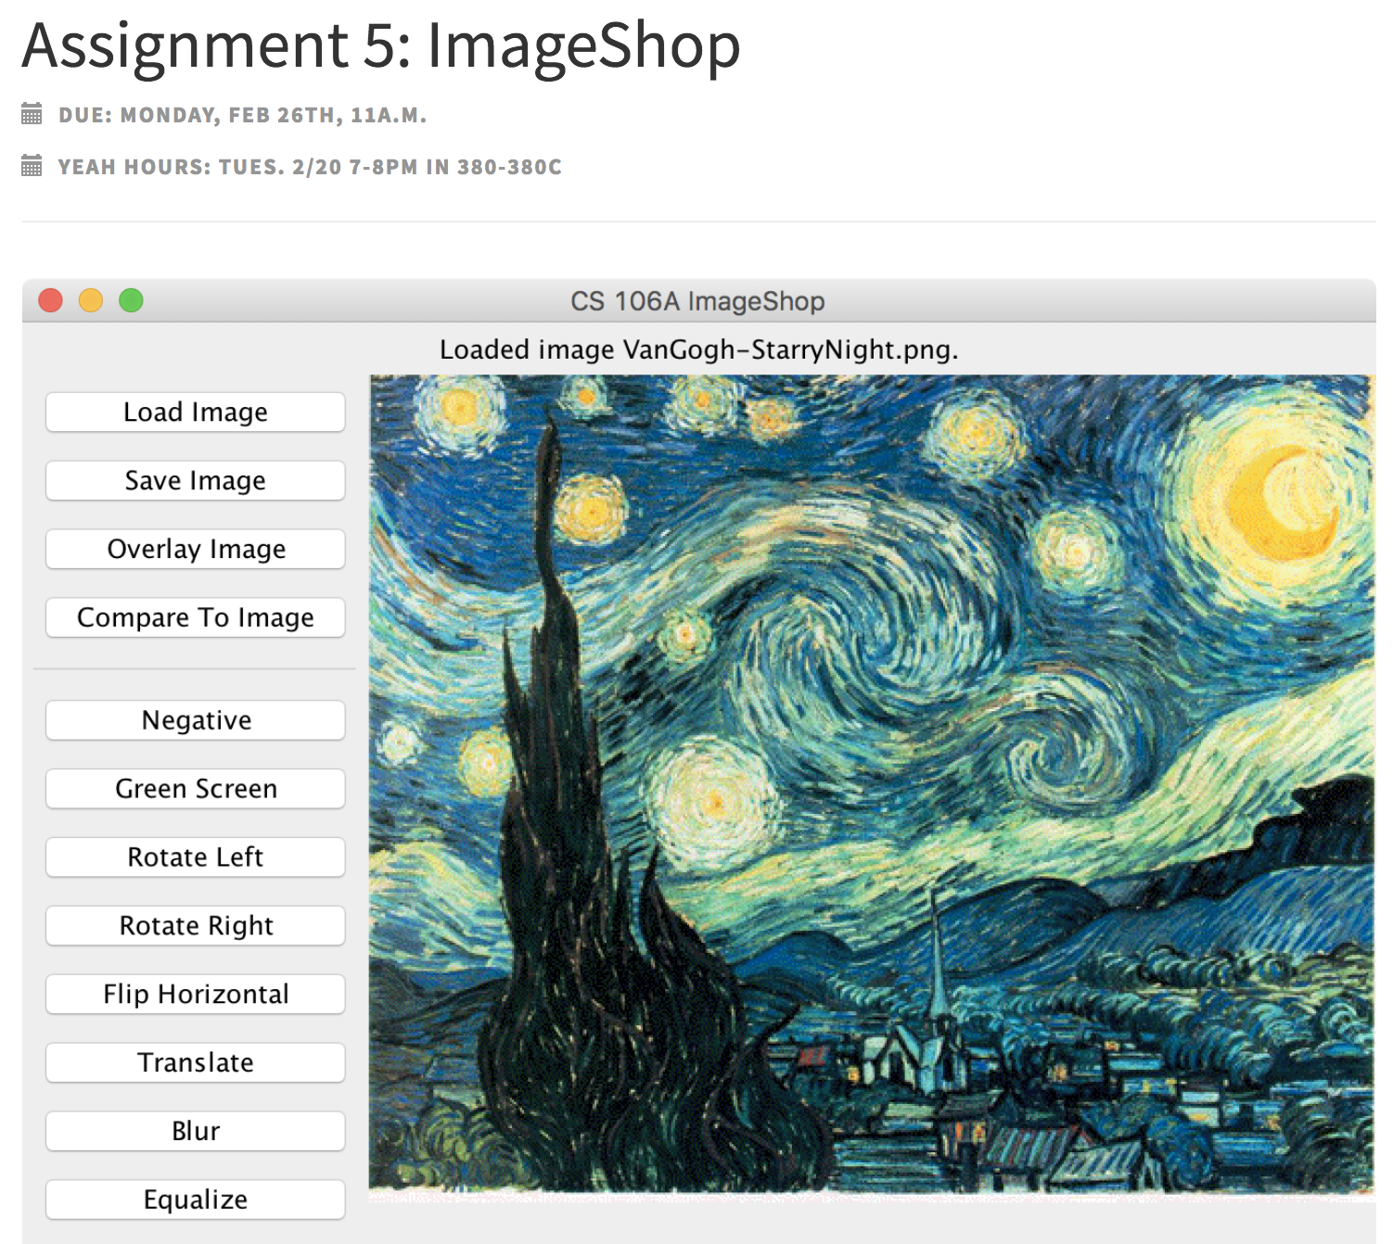
Look familiar?

Slide 16
Adding Iteractors
When you create an instance of any Program subclass, Java divides the window area into five regions as follows:
NORTH
WEST
EAST
CENTER
SOUTH
The CENTER region is typically where the action takes place. A ConsoleProgram adds a console to the CENTER region, and a GraphicsProgram puts a GCanvas there.
The other regions are visible only if you add an interactor to them. The examples in the text use the SOUTH region as a control strip containing a set of interactors, which are laid out from left to right in the order in which they were added.

Slide 17
JComponents
JComponent
JLabel
JButton
JTextField

Slide 18
JLabel

Slide 19
JLabel
JLabel label = new JLabel("Hi");

Slide 20
JLabel
JLabel label = new JLabel("Hi");

Slide 21
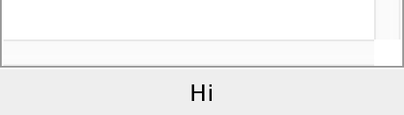
JLabel
JLabel label = new JLabel("Hi");
add(label, SOUTH);

Slide 22
JTextField

Slide 23
JTextField
JTextField field = new JTextField(10);
add(field, SOUTH);
...
field.getText(); // returns string in field
field.setText("Good times");

Slide 24
JTextField
JTextField field = new JTextField(10);
add(field, SOUTH);
...
field.getText(); // returns string in field
field.setText("Good times");

Slide 25
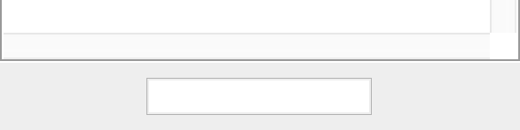
JTextField
JTextField field = new JTextField(10);
add(field, SOUTH);
...
field.getText(); // returns string in field
field.setText("Good times");

Slide 26
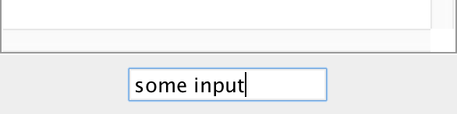
JTextField
JTextField field = new JTextField(10);
add(field, SOUTH);
...
field.getText(); // returns string in field
field.setText("Good times");

Slide 27
JTextField
JTextField field = new JTextField(10);
add(field, SOUTH);
...
field.getText(); // returns “some input”
field.setText("Good times");

Slide 28
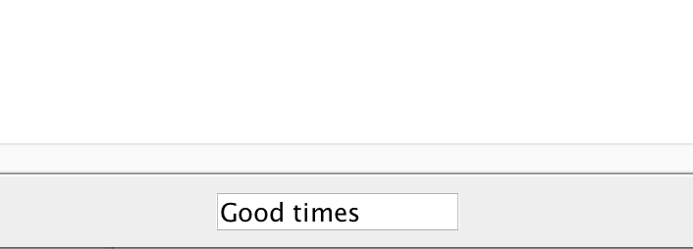
JTextField
JTextField field = new JTextField(10);
add(field, SOUTH);
...
field.getText(); // returns “some input”
field.setText("Good times");

Slide 29
JTextField
JTextField field = new JTextField(10);
add(field, SOUTH);
...
field.getText(); // returns “some input”
field.setText("Good times");
// now hitting enter will trigger action
textField.addActionListener(this);

Slide 30
JButton

Slide 31
JButton
JButton button = new JButton("Press me");

Slide 32
JButton
Button Text
JButton button = new JButton("Press me");

Slide 33
JButton
JButton button = new JButton("Press me");
add(button, SOUTH);

Slide 34
JButton
public void actionPerformed(ActionEvent e) {
println(e.getActionCommand());
}

Slide 35
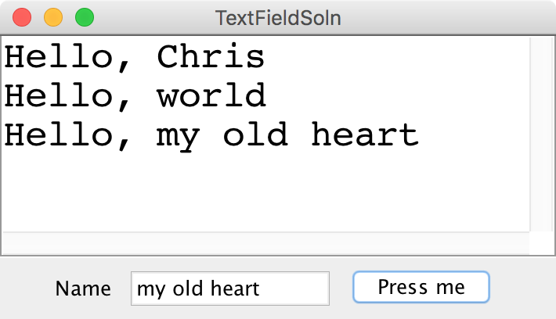
All together now
darkness
darkness

Slide 36
Recall the Dancing Children

Slide 37

Normal Program
Run Method

Slide 38
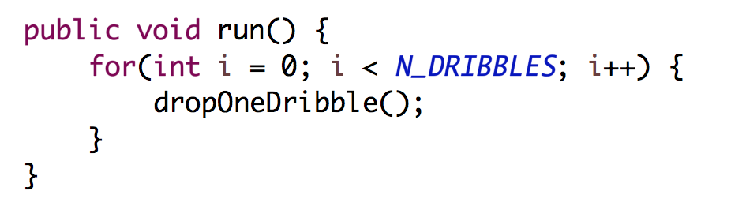
Normal Program
Run Method

Slide 39
Normal Program
Run Method

Slide 40
Normal Program
Run Method

Slide 41
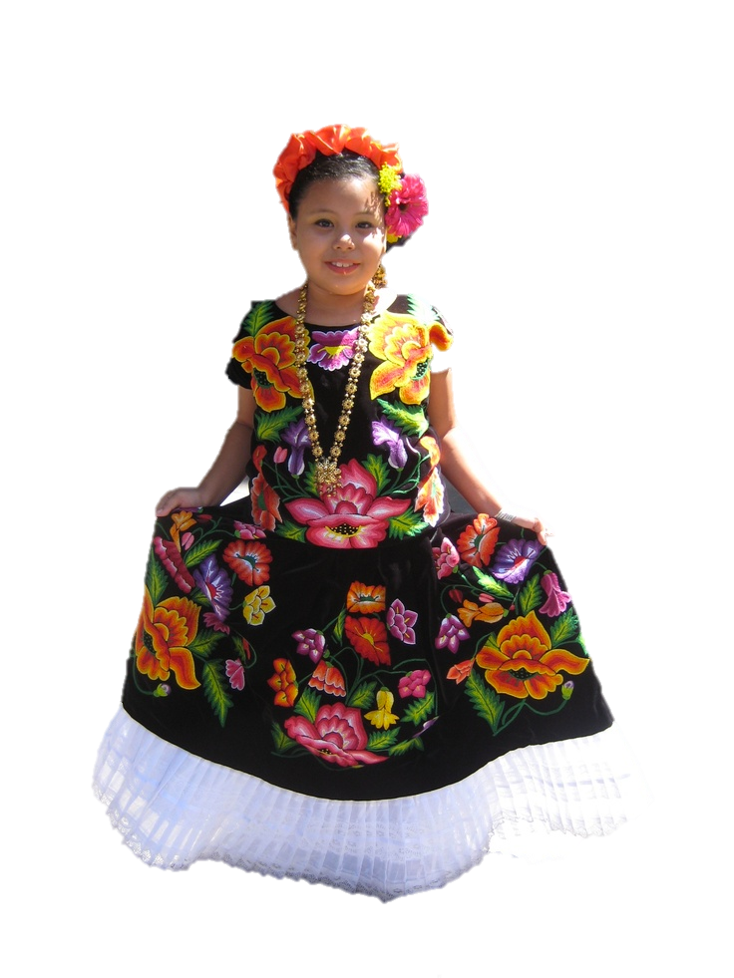
New Listener Characters
Action Listener
Action Performed

Slide 42
Program Starts Running
Run Method
Action Performed

Slide 43
Add Action Listeners
Run Method
Action Performed
Action Listener
addActionListeners();

Slide 44
Program Runs as Usual
Run Method
Action Performed
Action Listener

Slide 45

Button Clicked!
Run Method
Action Performed
Action Listener

Slide 46
Calls Action Performed Method
Run Method
Action Performed
Action Listener

Slide 47
When done, Run continues.
Run Method
Action Performed
Action Listener

Slide 48
Keeps Doing Its Thing…
Run Method
Action Performed
Action Listener

Slide 49
Button Clicked!
Run Method
Action Performed
Action Listener

Slide 50
Calls Action Performed Method
Run Method
Action Performed
Action Listener

Slide 51
When done, Run continues.
Run Method
Action Performed
Action Listener

Slide 52
Recall the Dancing Children

Slide 53
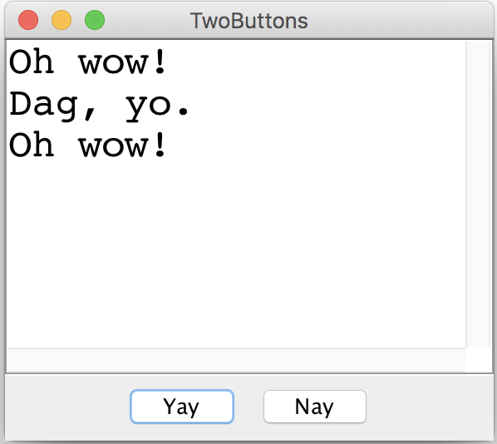
Two Buttons

Slide 54
something awesome
*idea credits to Keith

Slide 55

The XKCD Color Survey
Notes:
2/25/19
55
55

Slide 56
Notes:
2/25/19
56
56

Slide 57
Notes:
2/25/19
57
57

Slide 58
Notes:
2/25/19
58
58

Slide 59
The XKCD Color Survey
Volunteers (online) were shown a randomly-chosen color and asked to name the color.
The result is (after filtering) about 2.8 million RGB triplets and their names.
What do people think the colors are?
Notes:
2/25/19
59
59

Slide 60
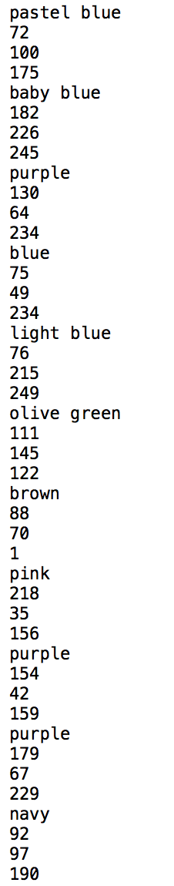
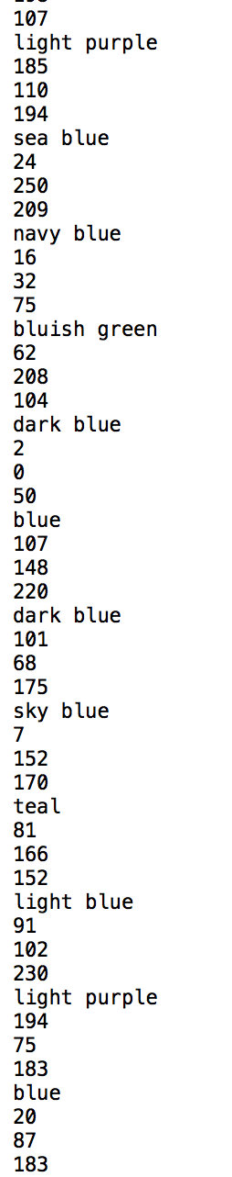
The File Format
color-name,
red,
green,
blue
Notes:
2/25/19
60
60

Slide 61
How to Structure Data
blue
15
137
255
0
0
127
88
88
190
red
166
14
7
99
55
5
255
0
0
gray
154
156
157
243
242
254
140
143
148
associate each color name
with a list of colors
Notes:
2/25/19
61
61

Slide 62
How to Structure Data
blue
15
137
255
0
0
127
88
88
190
red
166
14
7
99
55
5
255
0
0
gray
154
156
157
243
242
254
140
143
148
HashMap<color name, list of colors>
Notes:
2/25/19
62
62

Slide 63
How to Structure Data
blue
15
137
255
0
0
127
88
88
190
red
166
14
7
99
55
5
255
0
0
gray
154
156
157
243
242
254
140
143
148
HashMap<String, list of colors>
Notes:
2/25/19
63
63

Slide 64
How to Structure Data
blue
15
137
255
0
0
127
88
88
190
red
166
14
7
99
55
5
255
0
0
gray
154
156
157
243
242
254
140
143
148
HashMap<String, ArrayList<color>>
Notes:
2/25/19
64
64

Slide 65
How to Structure Data
blue
15
137
255
0
0
127
88
88
190
red
166
14
7
99
55
5
255
0
0
gray
154
156
157
243
242
254
140
143
148
BHashMap<String, ArrayList<Color>>B
Notes:
2/25/19
65
65

Slide 66
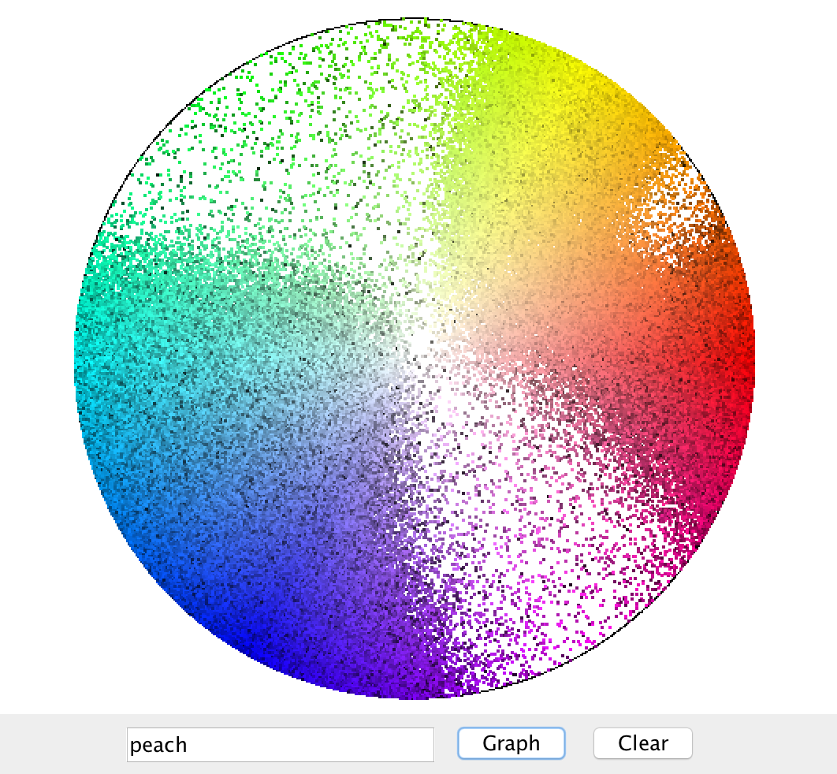
Displaying Colors
Notes:
2/25/19
66
66

Slide 67
Further Reading
http://blog.xkcd.com/2010/05/03/color-survey-results/
Notes:
2/25/19
67
67

